Slide 1


Session 5: Object-Oriented programming
Middlesex Computing Society: Python Programming
Arfa Kazi, Head of Python Programming

Slide 2

Last week’s recap
Understand the definition and importance of functions.
Learn how to declare and call functions.
Understand the concept of parameters and return values.
Practice importing and using built-in modules.

Slide 3

This Week’s objectives:
Understand the principles of Object-Oriented Programming (OOP).
Learn how to define and create classes and objects.
Understand and implement class attributes and methods.
Explore the concepts of inheritance, polymorphism, encapsulation, and abstraction.

Slide 4


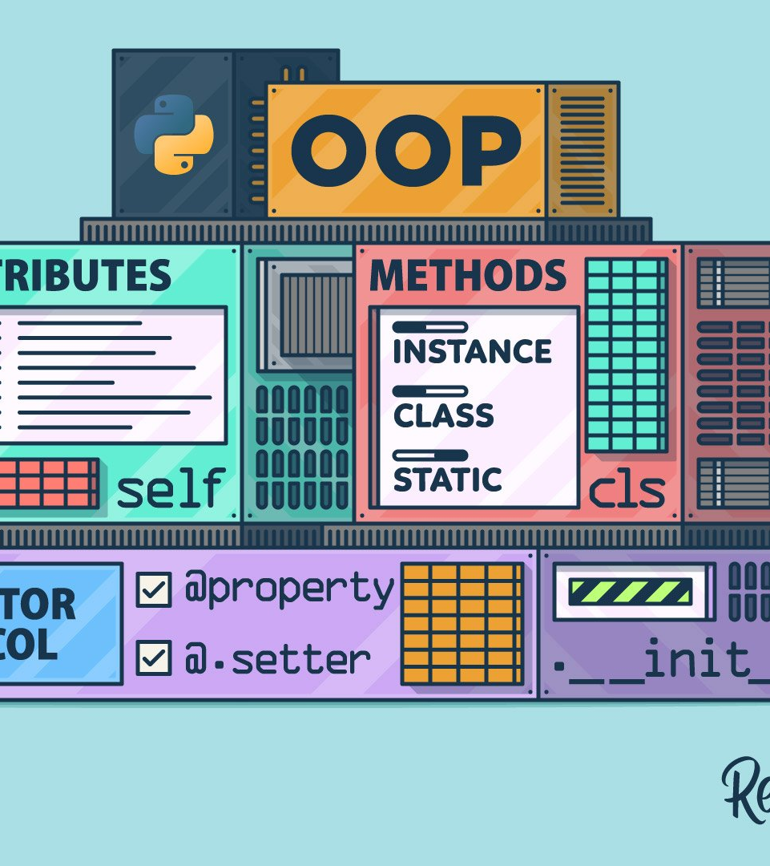
Introduction to Object-Oriented Programming (OOP)
Object-Oriented Programming (OOP) is a programming style that uses "objects" to design applications and computer programs. Objects can hold both data and methods.
Key Concepts:
Classes and Objects: Blueprints and instances.
Encapsulation: Bundling of data and methods.
Inheritance: Deriving new classes from existing ones.
Polymorphism: Using functions in different ways.
Abstraction: Hiding complex details and showing simple ones.

Slide 5

Classes and Objects
Classes: A class is a blueprint for creating objects. It defines a type of object.
Objects: An object is an instance of a class. It is a specific realization of the class with actual values.
Syntax:
class ClassName:
# attributes and methods
# Creating an object
object_name = ClassName()

Slide 6
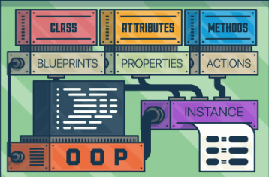
Class attributes and methods
Class attributes are variables that are shared among all instances of a class.
Class methods are functions that are bound to the class and not the instance of the class. Can modify class state that applies across all instances of the class.
Instance methods are methods that operate on instances of the class. Can access and modify instance attributes.

Slide 7
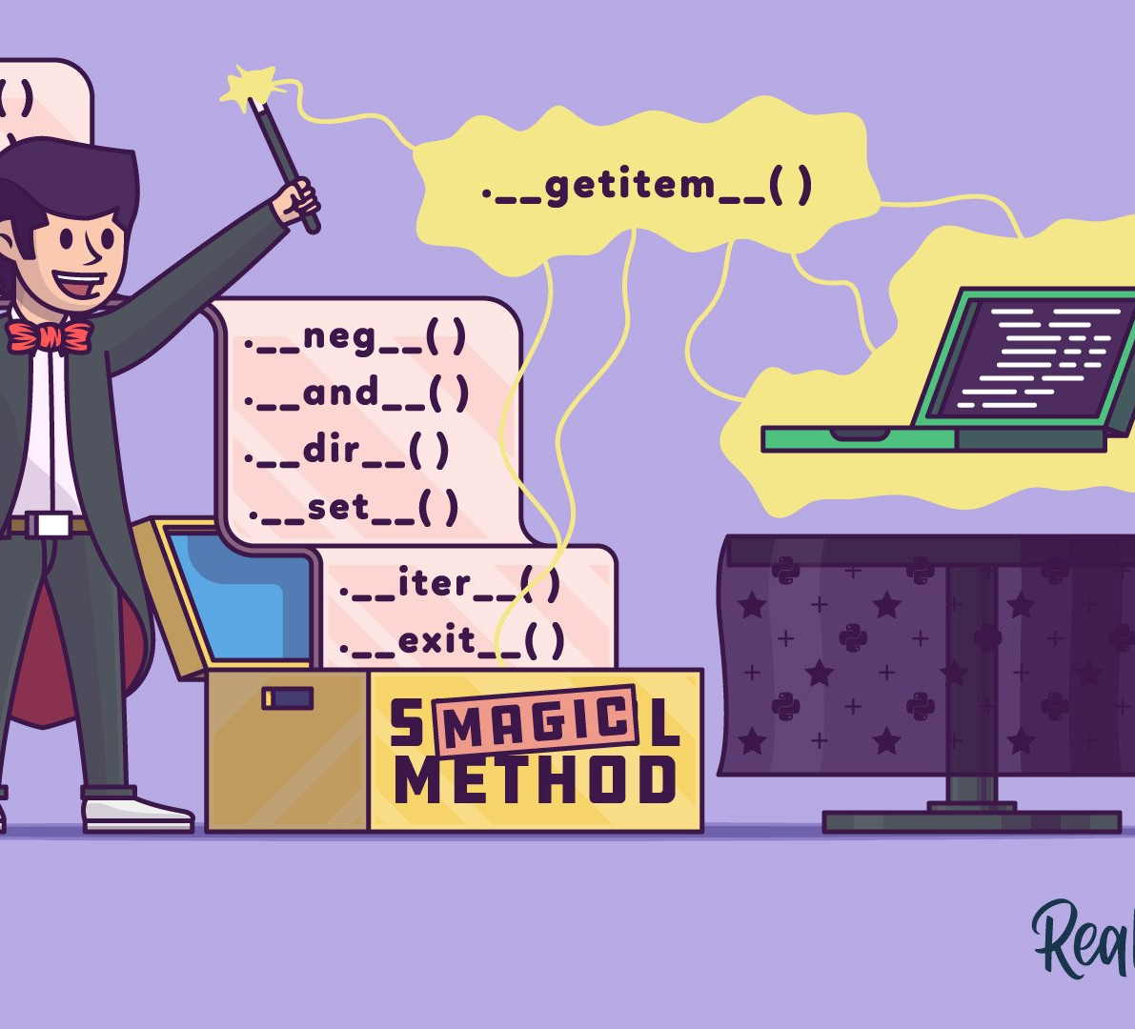
Special methods
Special methods in Python are methods that start and end with double underscores (__), also known as dunder methods.
Common Special Methods:
__init__: Constructor method, called when an instance is created.
__str__: String representation of the object.
__repr__: Official string representation of the object.
__len__: Returns the length of the object.

Slide 8
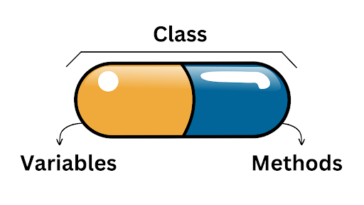
Encapsulation
Encapsulation is the practice of keeping fields within a class private, then providing access to them via public methods.
Access Modifiers:
Public: Accessible from anywhere.
Protected: Prefix with a single underscore (_), accessible within the class and subclasses.
Private: Prefix with double underscores (__), accessible only within the class.
Example:
class Person:
def __init__(self, name, age):
self.name = name # Public
self._age = age # Protected
self.__pwd = password # Private

Slide 9
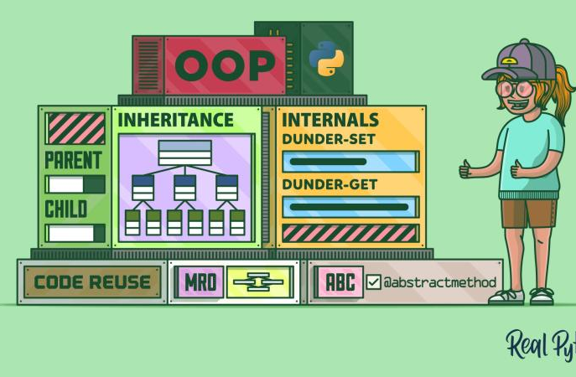
Inheritance
Inheritance allows one class (child class) to inherit the attributes and methods of another class (parent class).
Promotes code reuse and establishes a natural hierarchy.
class Parent: # Parent Class
def __init__(self, name):
self.name = name
def greet(self):
return f"Hello, {self.name}"
class Child(Parent): # Child Class
def play(self): # Method in child class
return f"{self.name} is playing!“ # Attribute from parent class

Slide 10
Polymorphism
Polymorphism allows methods to do different things based on the object it is acting upon.
Provides flexibility and allows different classes to be used interchangeably.
class Bird:
def fly(self):
print("Bird is flying")
class Airplane:
def fly(self):
print("Airplane is flying")
def let_it_fly(obj):
obj.fly()
bird = Bird()
airplane = Airplane()
let_it_fly(bird) # Output: Bird is flying
let_it_fly(airplane) # Output: Airplane is flying

Slide 11

Abstraction
Abstraction is the process of hiding complex implementation details and showing only the necessary features of an object.
Simplifies code and reduces complexity by allowing the user to interact with an object at a higher level.

Slide 12
Importing Modules and Using Classes
Importing in Python allows you to access code from another module or file within your project. This helps in organizing code into reusable and maintainable components.
Syntax:
from module_name import ClassName

Slide 13
Mini Test
Get all correct for a Prize!!
https://docs.google.com/forms/d/e/1FAIpQLSdzzA-EP5y8NdMVgcsEXa1X1oFbalSyLoDh5TzcWL5jzzjplA/viewform?usp=sf_link

Slide 14
Additional Resources
https://learn.microsoft.com/en-us/training/modules/python-object-oriented-programming/
https://realpython.com/
https://www.w3schools.com/python/python_classes.asp
https://www.geeksforgeeks.org/python-programming-language-tutorial/

Slide 15
Preview of Next Week!!
Understand the role and importance of libraries.
Learn how to install and import popular libraries.
Discuss the capstone project requirements and objectives.
Brainstorm and select a project idea based on learned concepts.

Slide 16

THANK YOU FOR STICKING TILL THE END!!!
Here is Another Special Easter Egg in Python
import antigravity
Try it in your Python shell and see the result!

Slide 17


